Slide 1
Spring Boot
Java Based Frame Work

Slide 2
What is Spring Boot?
Spring Boot is an open source Java-based framework used to create a micro Service.
It is developed by Pivotal Team and is used to build stand-alone and production ready spring applications.
What is Micro Service?
Micro service is architectural way to design our application uniquely with several small Modules developed individually, packaged individually, and deployed individually, in individual process.
Each service running has its own process and this achieves the lightweight model to support business applications.
Advantages:
Easy deployment
Simple scalability
Minimum configuration
Lesser production time

Slide 3
Why Micro Services?
Previously we are developing our applications in efficient way in monolithic approach.
In this we are developing our every service individually and at the end of developing we are packaging all services as single war file and deploying in server.
Dis-advantages in monolithic approach:
performance issue due to huge data
continuous deployment not possible
adopting new technologies will be difficult

Slide 4
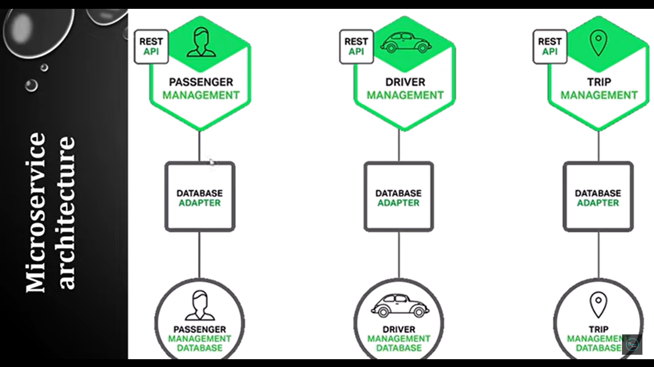
How Micro Services work?

Slide 5
What is Spring Boot?
Spring Boot provides a good platform for Java developers to develop a stand-alone and production-grade spring application that you can just run.
You can get started with minimum configurations without the need for an entire Spring configuration setup
Advantages:
Easy to understand and develop spring applications
Increases productivity
Reduces the development time

Slide 6
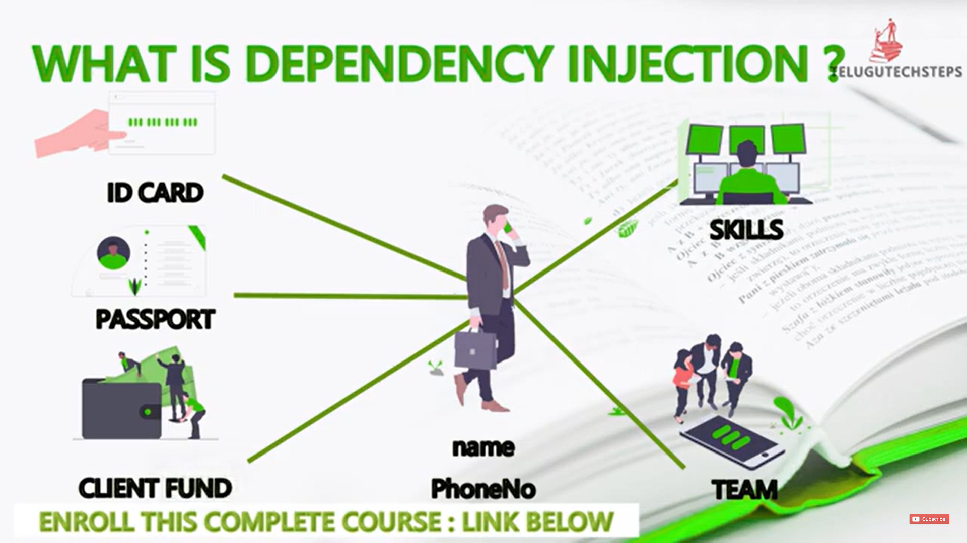
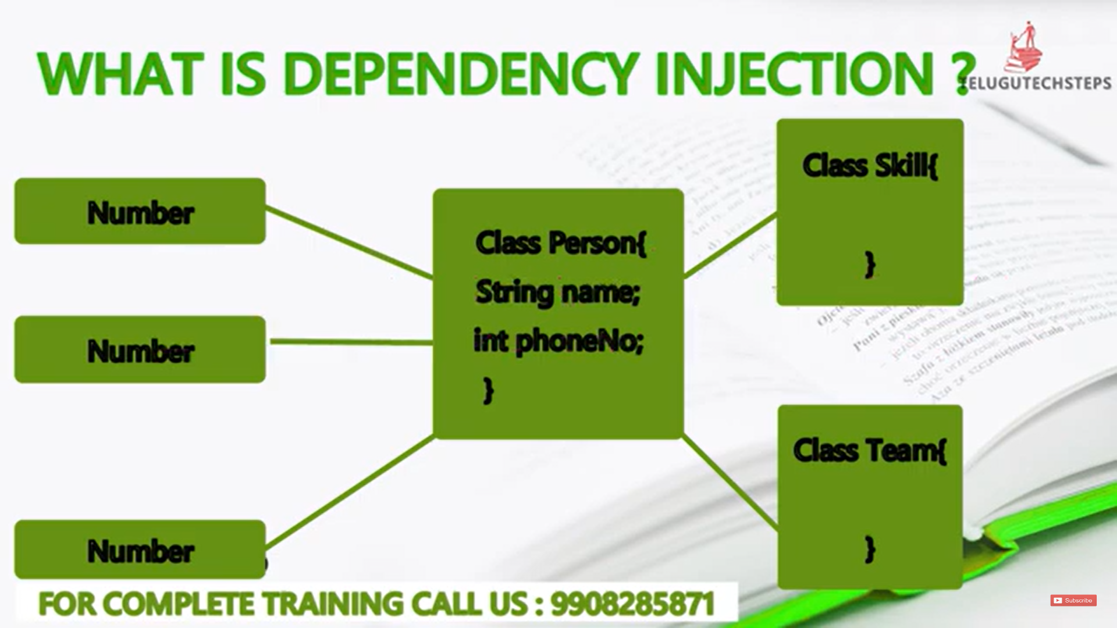
Dependency Injection
Dependency Injection is a fundamental aspect of the spring framework through which the spring container “injects” objects into other objects or dependency.

Slide 7
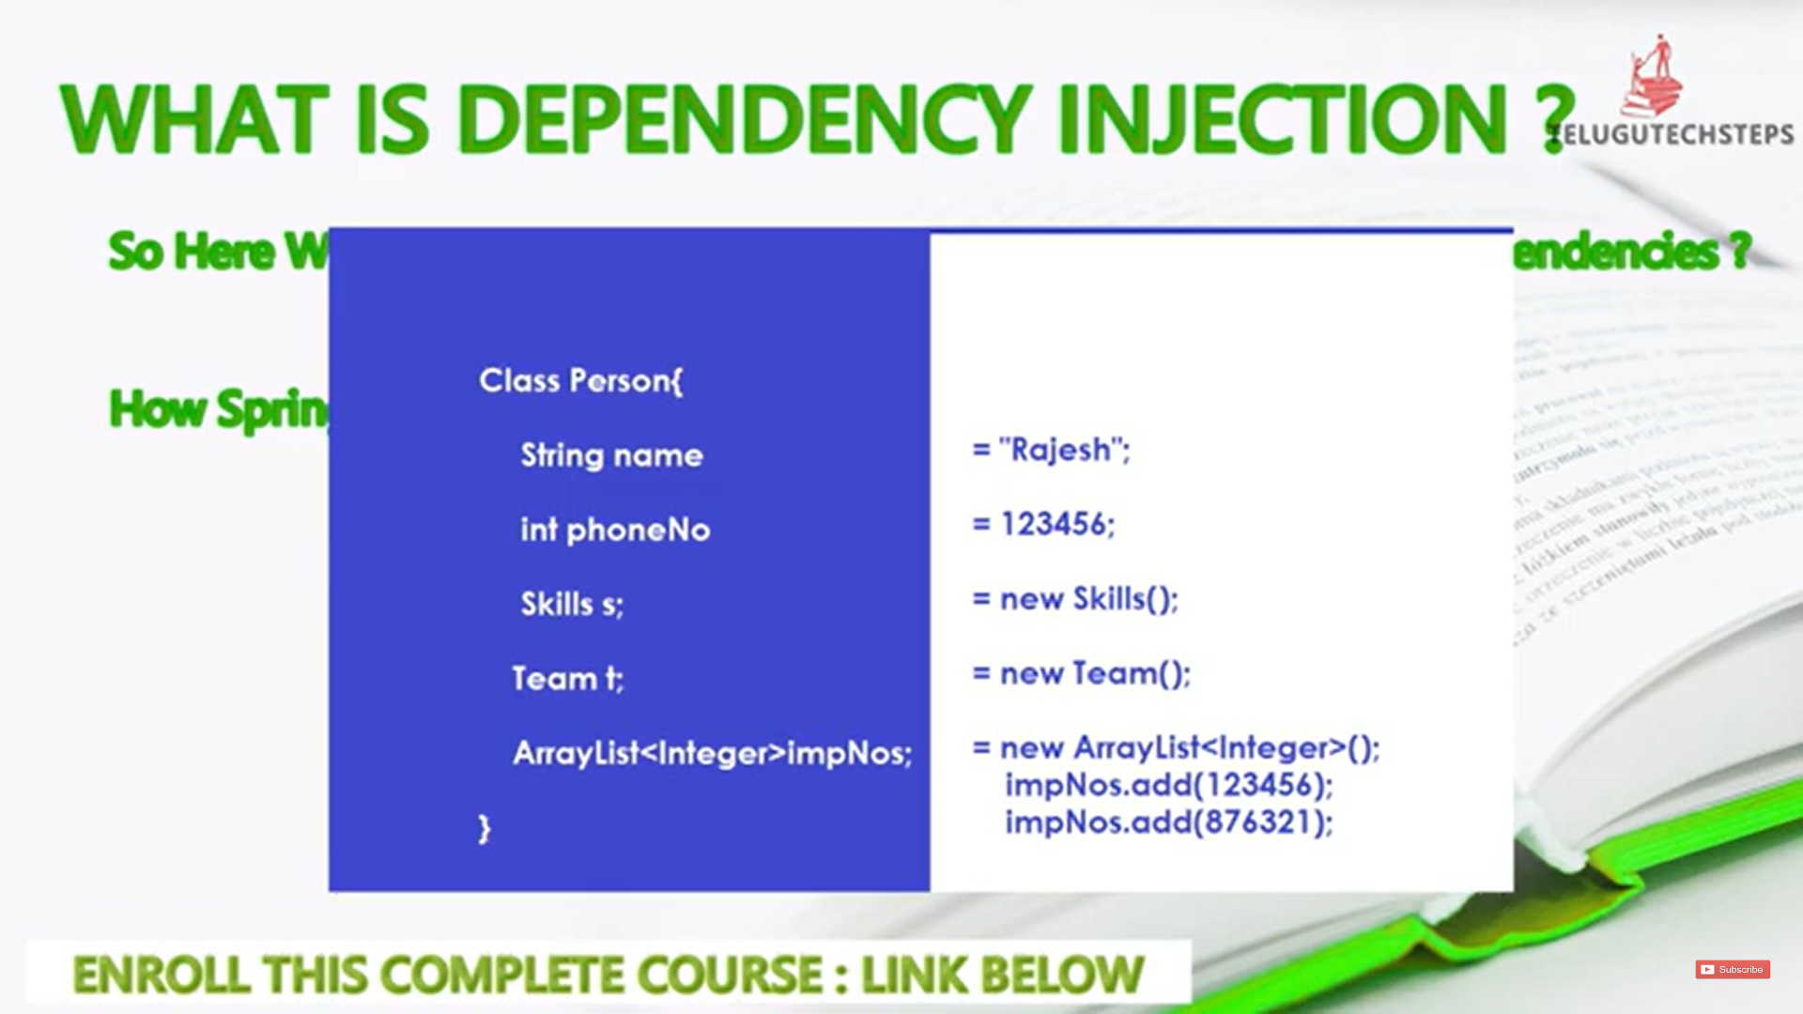
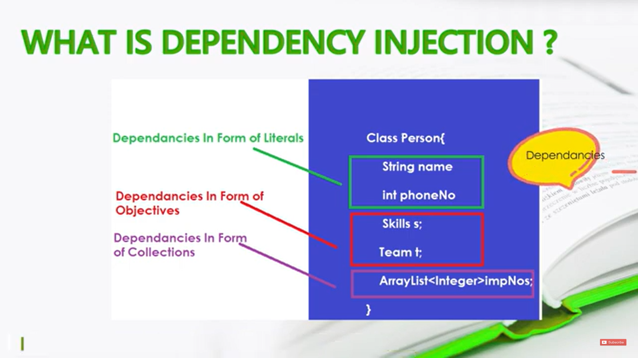
Dependency Injection

Slide 8
Types of Spring Dependency Injection:
Setter Dependency Injection (SDI):
This is the simpler of the two DI methods. In this, the DI will be injected with the help of setter and/or getter methods.
Ex:
public class Demo {
int Id;
public void setId(int Id){
this.Id = Id;
}
}

Slide 9
Types of Spring Dependency Injection:
Constructor Dependency Injection (CDI):
In this, the DI will be injected with the help of constructors.
Ex:
public class Demo {
int Id;
Demo(int Id){
this.Id = Id;
}
}

Slide 10
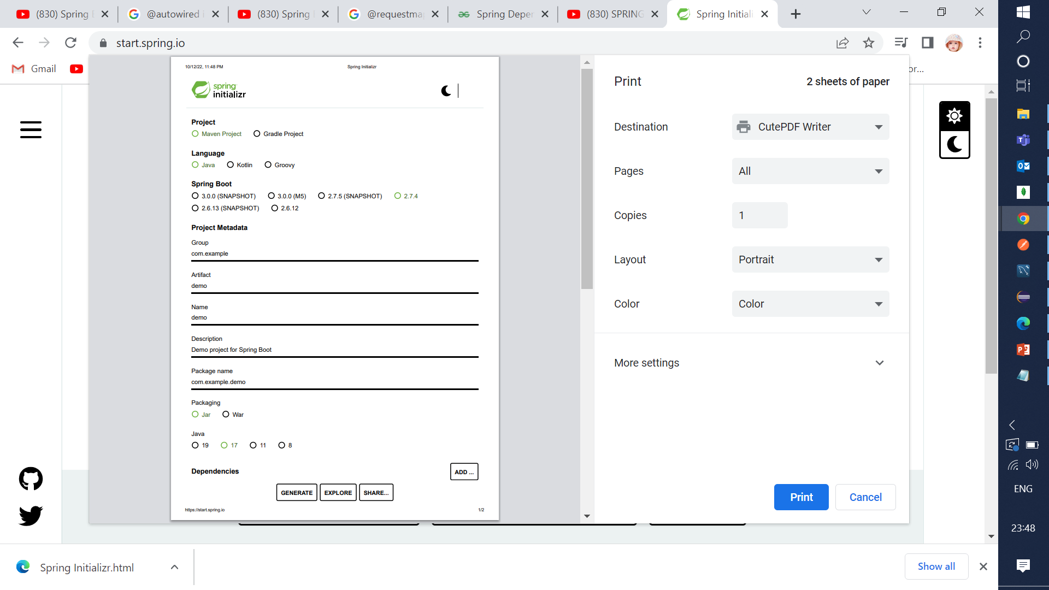
Creating Simple Spring Boot Application
Tools to be Installed:
JDK
Spring tool suit or eclipse
Postman
Open the Spring initializer https://start.spring.io.
Provide the Group and Artifact name.
Now click on the Generate button.
Maven is a popular open-source build tool developed by the Apache Group to build, publish, and deploy several projects at once for better project management

Slide 11
Spring Rest Annotations
Annotations are a form of metadata that provides data about a program.
It is used to provide supplemental information about the program.
Spring Annotations:
@GetMapping
@PostMapping
@PutMapping
@PatchMapping
@DeleteMapping
@RestController
@RequestMapping
@RequestBody
@RequestParam
@PathVariable

Slide 12
Spring Rest Annotation
@GetMapping
Annotation for mapping HTTP GET requests onto specific handler methods
It get the data from the specific handler
@PostMapping
Annotation for mapping HTTP POST requests to specific handler methods
It post the data to specific handler
@PutMapping
After Posting the data if we need any changes or updates it is used.
@PatchMapping
After Posting the data if we need any changes or updates it is used.
@DeleteMapping
To delete the data from specific handler method.

Slide 13
Spring Rest Annotation
@RestController
It is class Level Annotation
endpoint
@RequestMapping
It is either class Level Annotation or Method level annotation
Allows easy mapping of url parameters.
@RequestParam
used to extract query parameters
@PathVariable
used to extract data right from the URI.

Slide 14
THANK YOU

